Slide 1

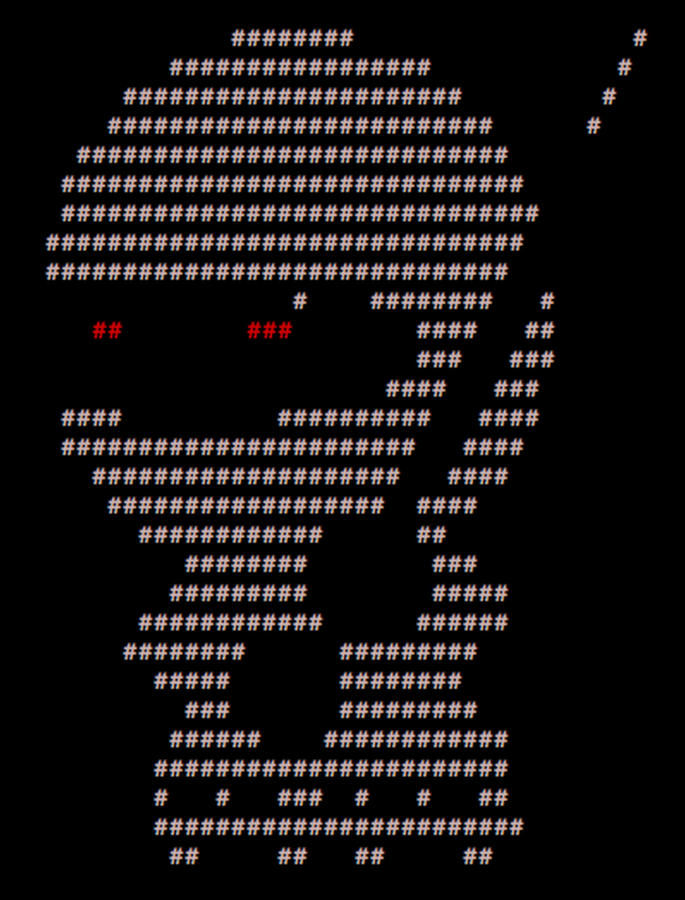
____ _____ _ _
/ ___| ___ __|_ _|_ _| | | _____
\___ \ / _ \/ __|| |/ _` | | |/ / __|
___) | __/ (__ | | (_| | | <\__ \
|____/ \___|\___||_|\__,_|_|_|\_\___/
PER0x56
Technical (in)security talks & hands-on challenges, no bullshit!
Technical (in)security talks & hands-on challenges, no bullshit!

Slide 2
Welcome!
We’re back!
Greetings nerds
Technical (in)security talks & hands-on challenges, no bullshit!

Slide 3
SecTalks PER0x56
Thanks to…
Evildaemond and sudosammy for the brews!
Spacecubed & Riff!
The committee: nidogski & sudosammy
Everyone who contributes!
Technical (in)security talks & hands-on challenges, no bullshit!
Notes:
Have a line up of lightening talks tonight

Slide 4
Speakers PER0x56
#1 – David Glance Synopsis: The skeptic’s view of MITRE ATT&CK: Good luck identifying that APT! Bio: Senior Lecturer at UWA where I teach cybersecurity amongst other things. Recently written a book (Ethical Hacking with Hack The Box) which is available online for free. I do research in the areas of cybersecurity and privacy.
Technical (in)security talks & hands-on challenges, no bullshit!
Notes:
Conor is an evolutionary mass of atoms whose sole instinct is survival. Works as a Security Analyst who primarily focuses on detection engineering and data analysis – finding data, gathering data, parsing data, employing that data to do wonderful things. He embodies the ‘fuck around and find out’ mindset and applies it to every project.

Slide 5

SecTalks PER0x57
Date: ????
(the randomest day of every month)
Speaker: ??? ← This could be you!
Title: ??? ← This could be anything!
https://goo.gl/4FT53i
Technical (in)security talks & hands-on challenges, no bullshit!

Slide 6

SecTalks PER0x57
And also…
Technical (in)security talks & hands-on challenges, no bullshit!

Slide 7



Stay in touch
IRC / SLACK
irc.sectalks.org > #sectalks
and / or ask to be added to the slack
Github
https://github.com/sectalks/sectalks
Twitter
@SecTalks
Technical (in)security talks & hands-on challenges, no bullshit!

Slide 8
Without further ado...
drinks?
~ ~
( o )o)
( o )o )o)
(o( ~~~~~~~~o
( )' ~~~~~~~'
( )|) |-.
o| _ |-. \
o| |_||_) | \ \
| | ||_) | | |
o| | / /
| |." "
| |- '
.========.
Technical (in)security talks & hands-on challenges, no bullshit!

